Slide 1
I.T. Department Portal
Shivajirao S. Jondhale College of Engineering, Dombivli(E)
Presented by:-
1)Girish Mahajan
2)Harshad Salunke
3)Hemangi Thoke

Slide 2
Introduction
A centralized web application to manage the academic and administrative activities of the IT Department.
The system is built around three distinct user roles to ensure security and efficiency: HOD (Admin), Faculty, and Student.
To provide each user type with a tailored experience, giving them access only to the tools and information they need.
The Core Concept of the overall project is providing easy access and functionality to users of IT department.

Slide 3
Literature Survey
Studied current College ERP & manual systems and worked accordingly for IT department portal.
Most systems are either too complex and expensive, or too simple and lack specific role-based features.
A need for a web-based system specifically designed for departmental management with clear separation of duties for HOD, faculty, and students.
Hence, we found that heavy licensing fees, subscription models, and additional hardware requirements, which are not financially feasible for individual departments.

Slide 4
Problem Statement
The Core Problem : IT departments lack a single, integrated platform to manage their complex operations.
This leads to scattered data, communication gaps, and administrative inefficiencies.
HODs struggle to get a complete overview and generate consolidated reports.
Faculty time is utilized on manual data entry for marks and attendance.

Slide 5
Objectives
To allow faculty to enter, update, and manage internal assessment while enabling HODs to monitor student performance at a glance.
To simplify the creation, updating, and sharing of departmental timetables for faculty and students.
To minimize manual tasks like maintaining paper records and Excel sheets, thereby saving faculty time and reducing errors.
To maintain all departmental information (attendance, marks, timetables, notices, student records) in a single, unified platform.
To provide an intuitive, simple, and easy-to-use interface that requires minimal technical expertise.

Slide 6
Existing System
Existing Systems Analysis : Studied current College ERP & manual systems.
Most systems are either too complex and expensive, or too simple and lack specific role-based features.
A need for a web-based system specifically designed for departmental management with clear separation of duties for HOD, faculty, and students.
High costing, subscription models, & additional hardware requirements, which are not financially feasible for individual departments.

Slide 7
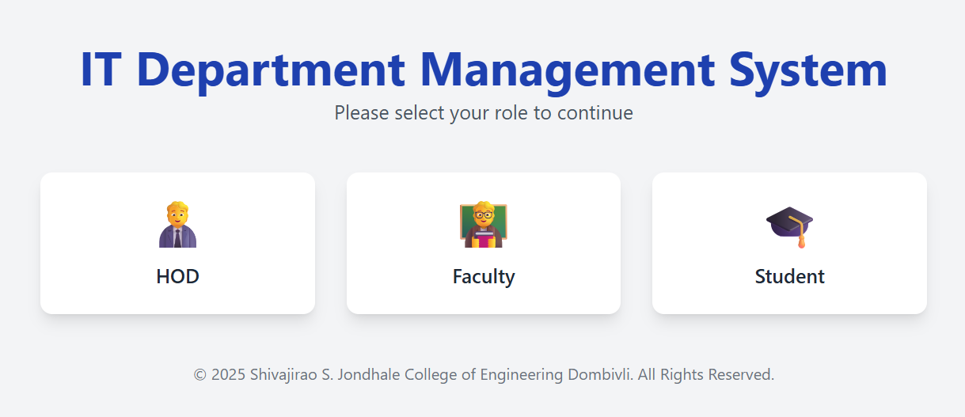
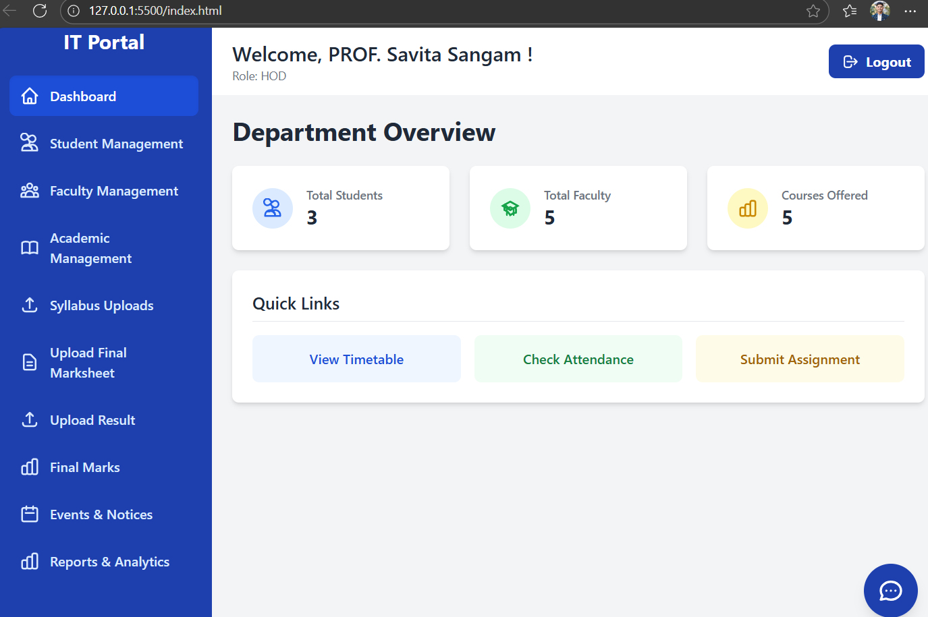
Proposed System
Fig No.1 : Main Page
Fig No.2 : HOD Page

Slide 8
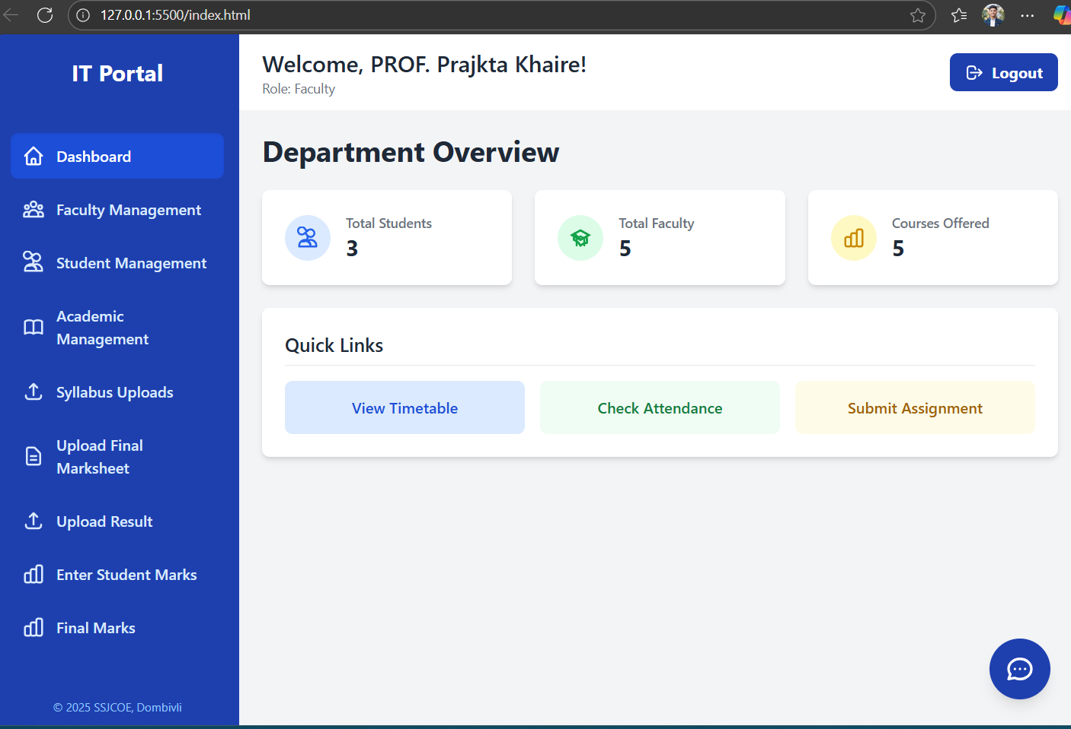
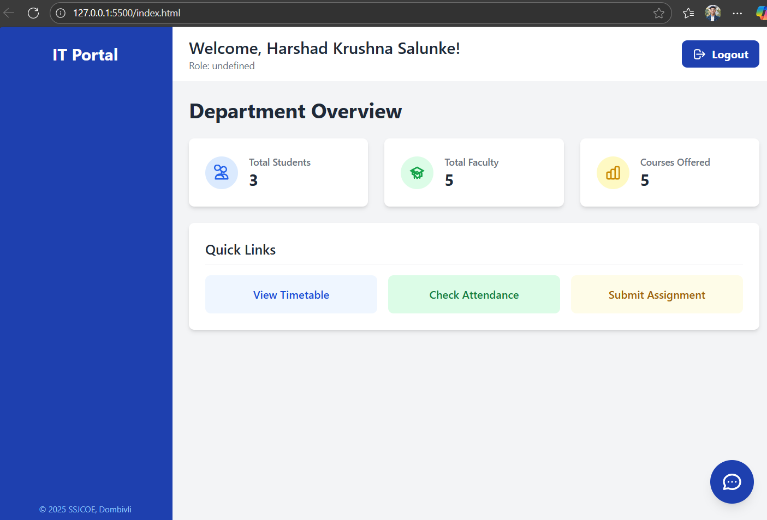
Proposed System
Fig No.3 : Faculty Page
Fig No.4 : Student Page

Slide 9
System Requirements
Software Requirements :
Front - End : HTML, CSS & JavaScript.
Database : MYSQL
Hardware Requirements :
Standard Specification PC or Laptop.
Web browser.

Slide 10
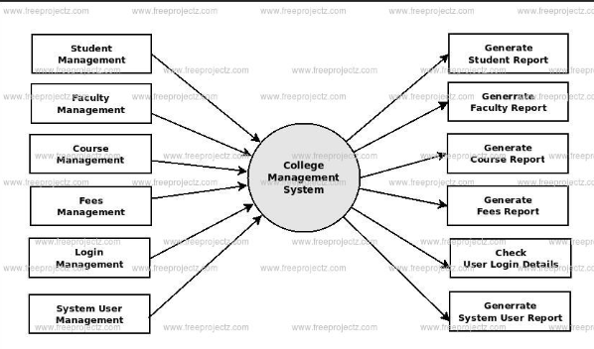
System Architecture
IT department Portal system
Fig No.5 : System Architecture

Slide 11
Implementation Details
HOD Module:
User Management: Can add, edit, or remove Students and Faculty.
Academic Management: Defines courses, subjects, and academic years.
Results & Documents: Uploads and finalizes results and documents.
Faculty Module:
Dashboard: Shows personal timetable and important notices.
Student Management: View details of students in their assigned classes.
Marks & Results Entry: Can enter, upload, and manage marks & subjects.
Student Module:
Personalized Dashboard: Displays key info like attendance percentage and recent results.
Academic Records: Access to "Attendance" and "Results".
Resources: View Timetable, Assignments, and Library Resources.

Slide 12
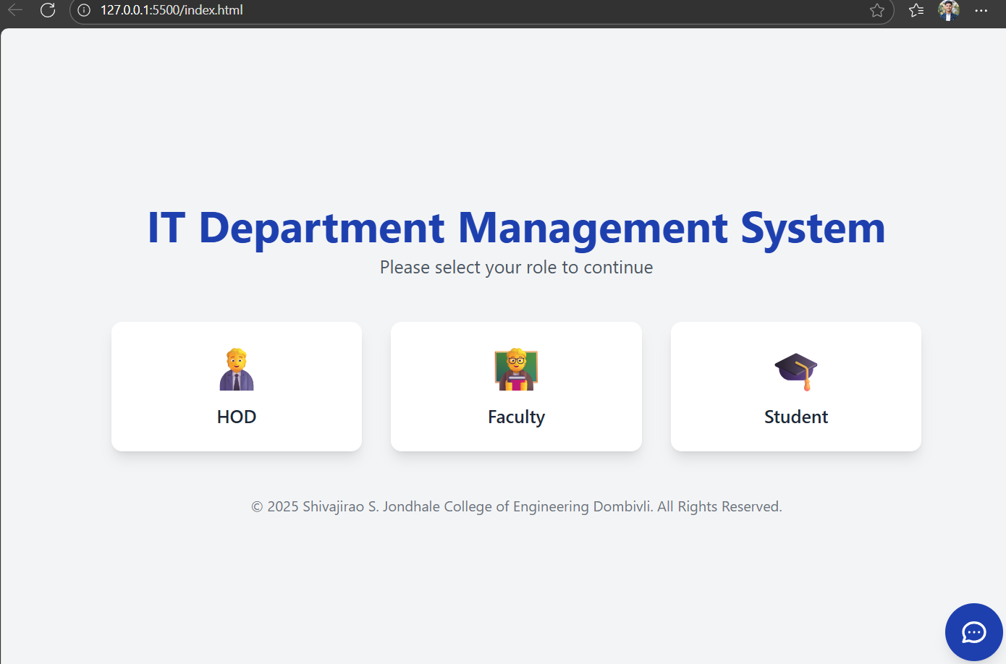
Result and Output

Slide 13
Result and Output

Slide 14
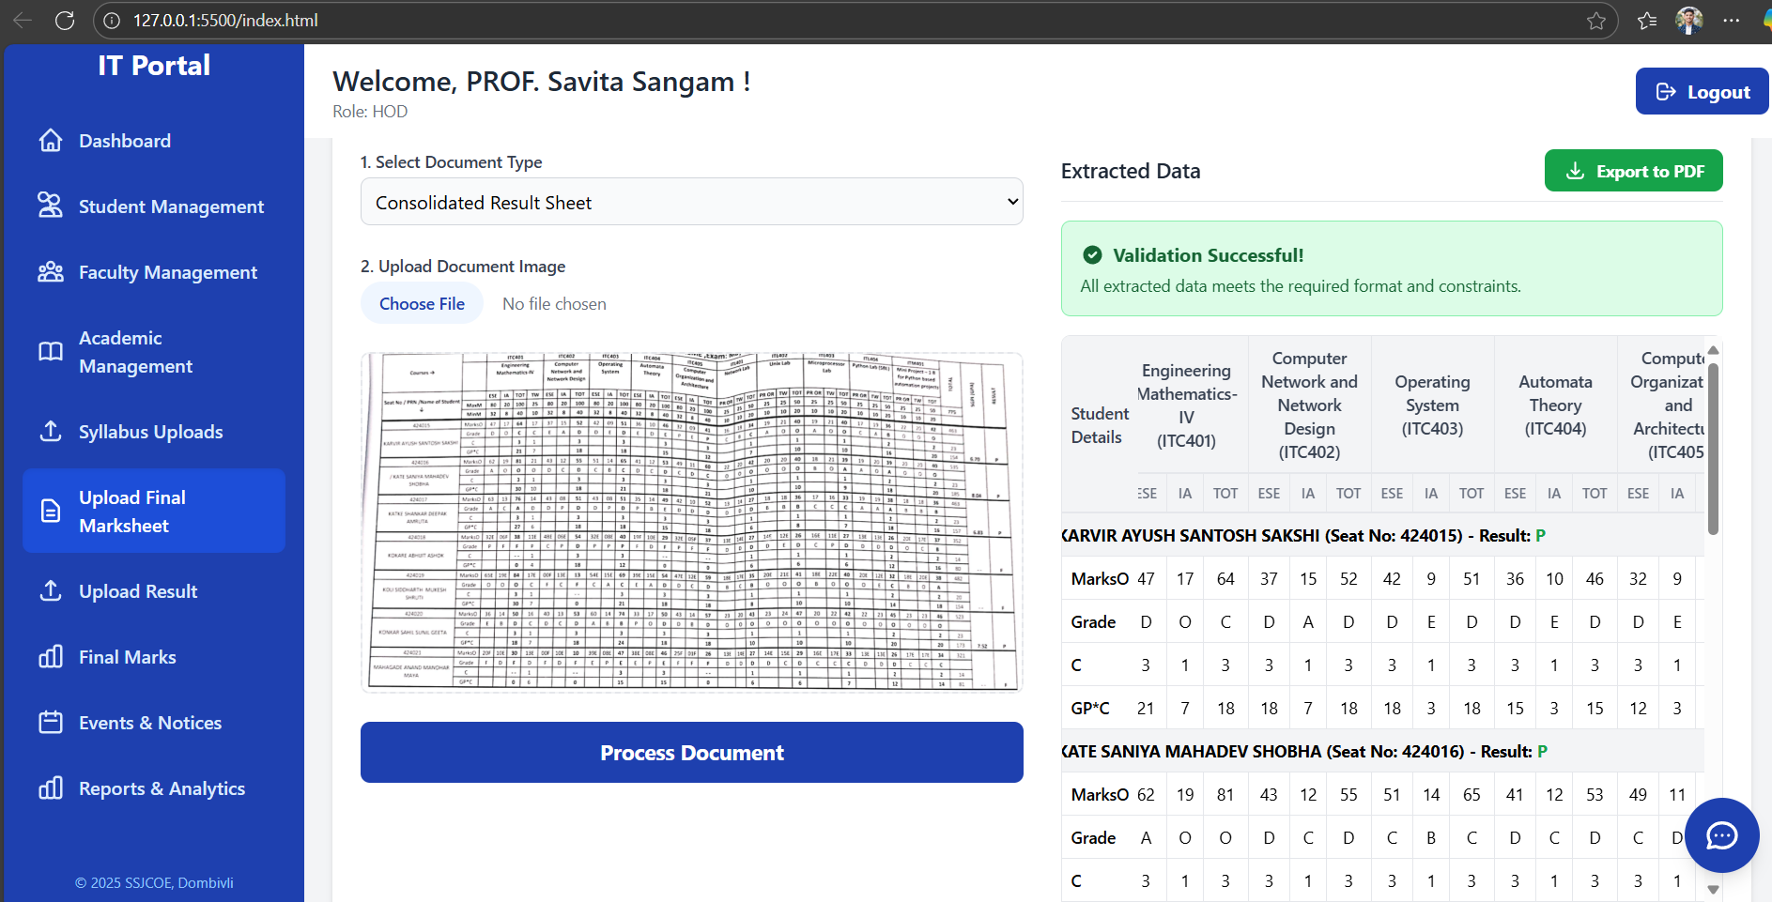
Result and Output

Slide 15
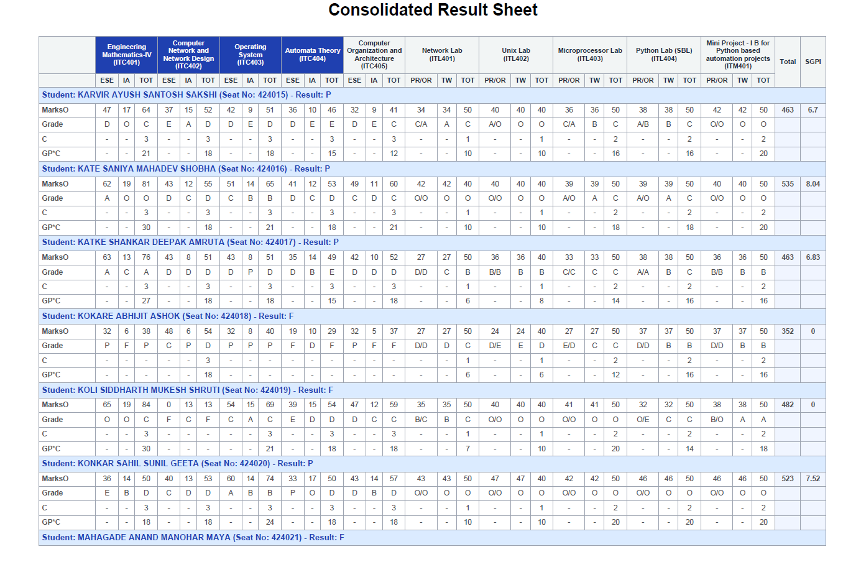
Result and Output

Slide 16
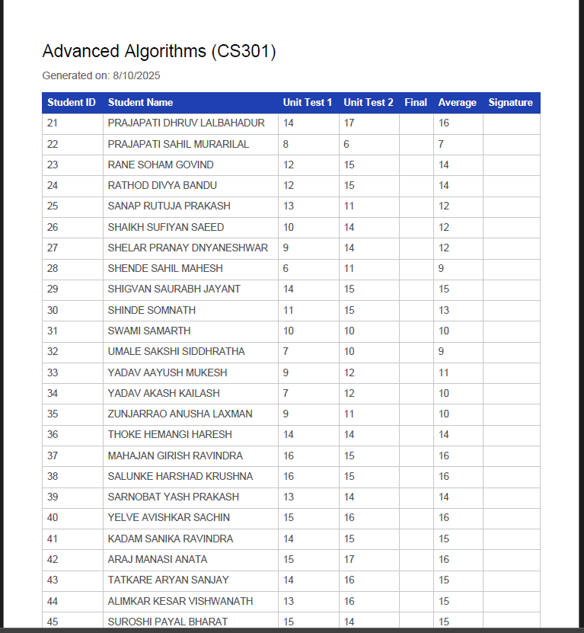
Result and Output

Slide 17
Conclusion
The IT Department Portal is a challenge of manual and scattered departmental processes by providing a centralized, web-based solution. With role-based access for HOD, faculty, and students, the system ensures efficient management of attendance, marks, timetables, notices, and project submissions. It reduces paperwork, minimizes errors, enhances communication.

Slide 18
References
W3Schools - Accessed for HTML and JavaScript tutorials for references.
Geeks-for-Geeks -Used for backend and database implementation references.
Tutorials-Point-General programming and project-related concepts.
College ERP & Departmental Systems Case Studies (reviewed during literature survey).

Slide 19
Thankyou!

